Slide 1

Customer Retention Analysis
Submitted by :
Abhishek Mishra

Slide 2
Introduction
The customer retention definition in marketing is the process of engaging existing customers to continue buying products or services from your business. The best customer retention tactics enable you to form lasting relationships with consumers who will become loyal to your brand. They might even spread the word within their own circles of influence, which can turn them into brand ambassadors.
Successful e-commerce brands are often the ones that focus on their customer retention rate and keep working to improve it.

Slide 3
Problem Statement
Customer satisfaction has emerged as one of the most important factors that guarantee the success of online store; it has been posited as a key stimulant of purchase, repurchase intentions and customer loyalty. A comprehensive review of the literature, theories and models have been carried out to propose the models for customer activation and customer retention. Five major factors that contributed to the success of an e-commerce store have been identified as: service quality, system quality, information quality, trust and net benefit. The research furthermore investigated the factors that influence the online customers repeat purchase intention. The combination of both utilitarian value and hedonistic values are needed to affect the repeat purchase intention (loyalty) positively.

Slide 4
Data Analysis

Slide 5
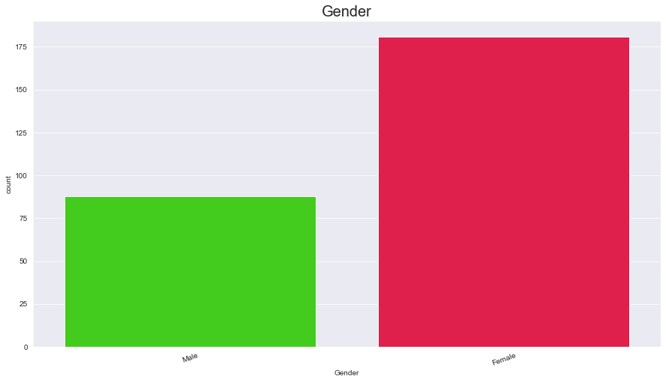

Slide 6
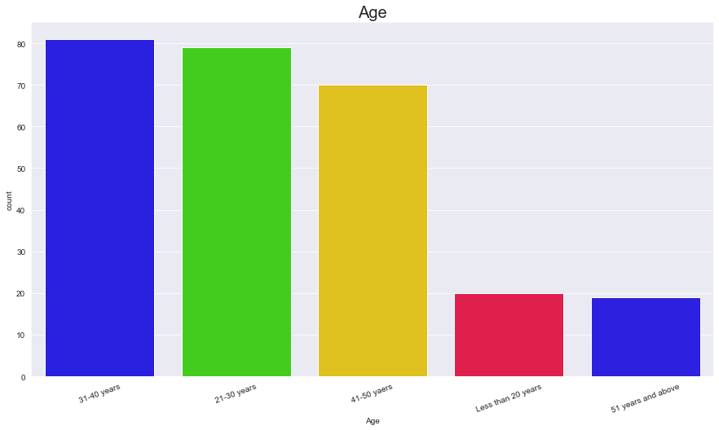

Slide 7
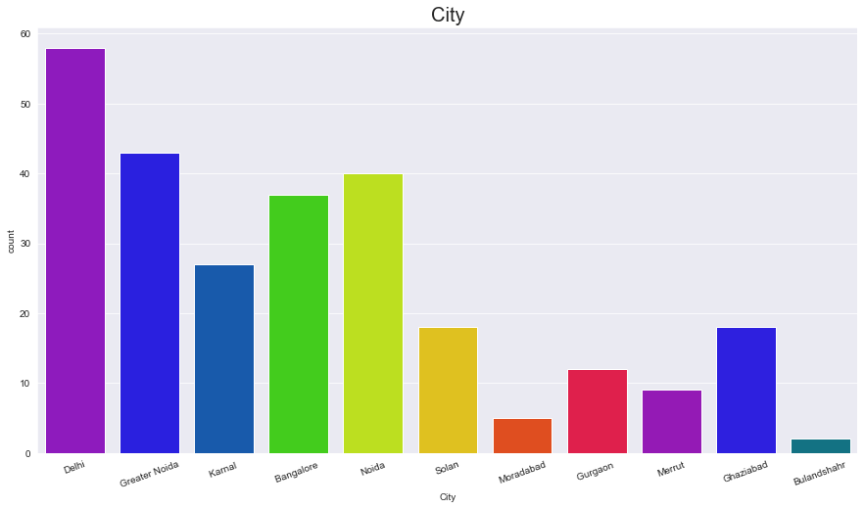

Slide 8
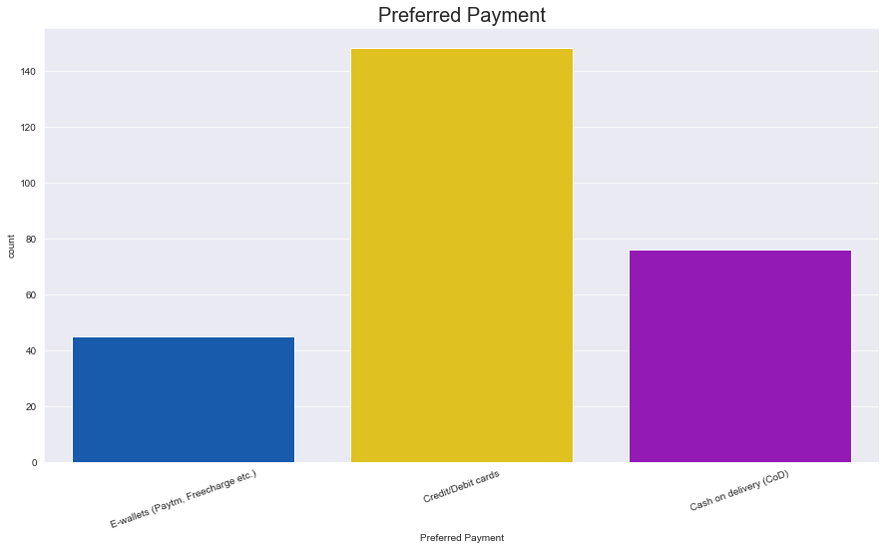

Slide 9
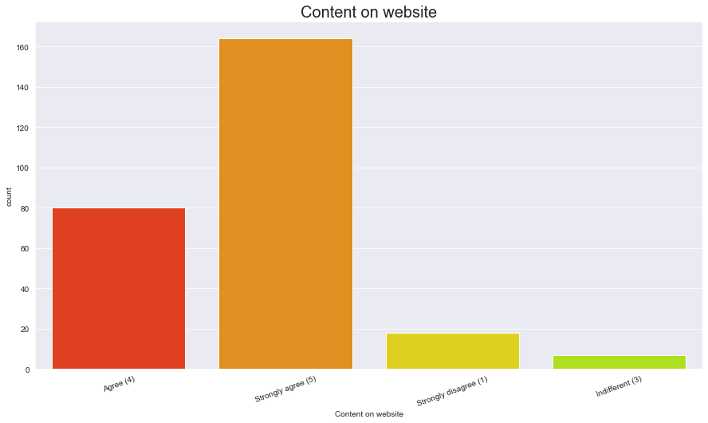

Slide 10
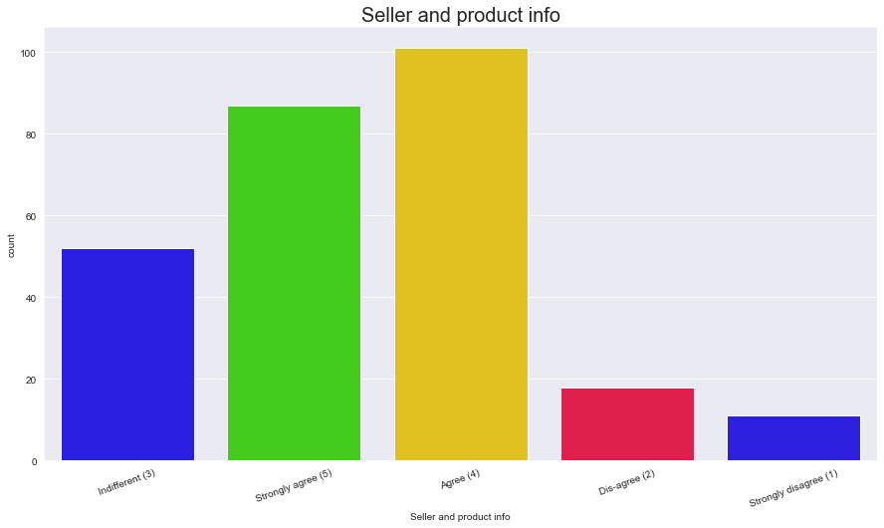

Slide 11
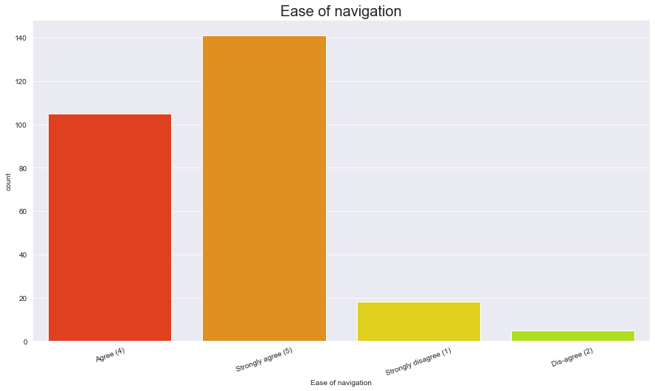

Slide 12
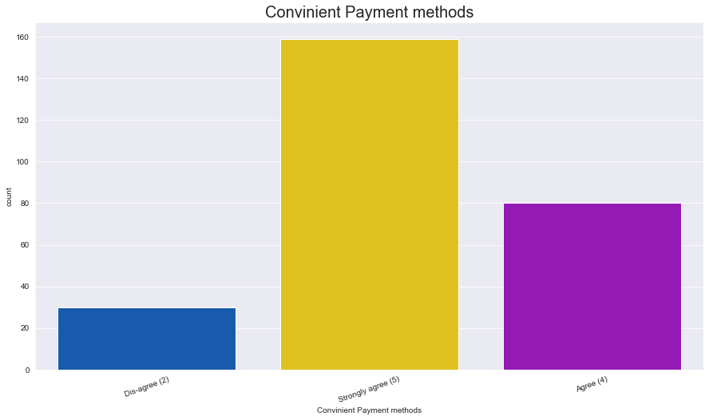

Slide 13
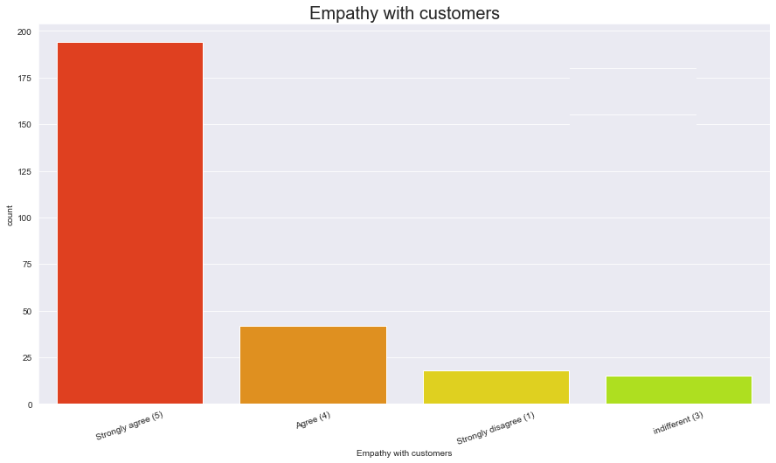

Slide 14
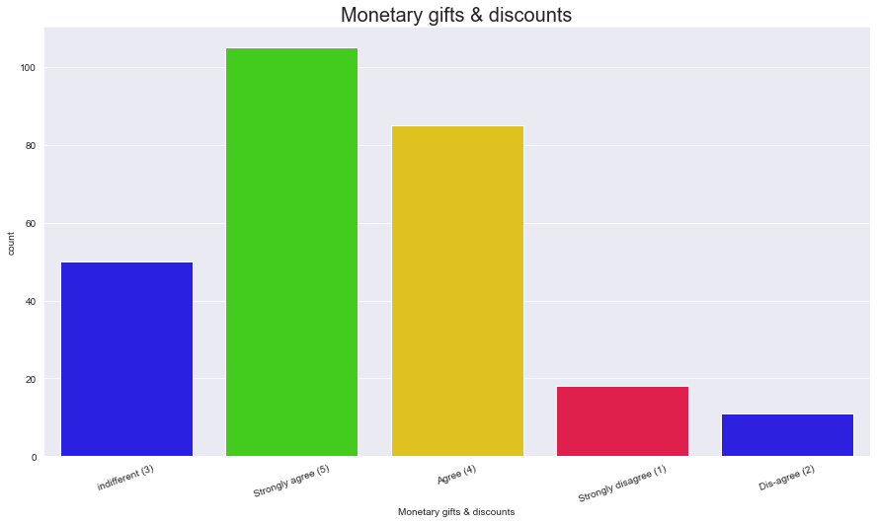

Slide 15
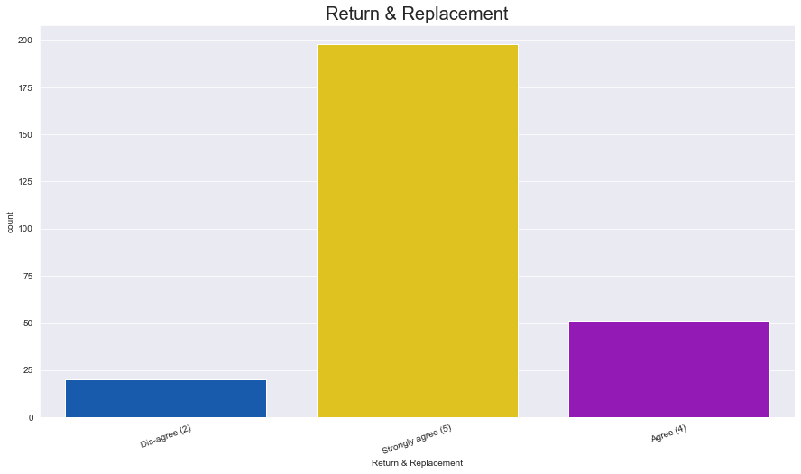

Slide 16
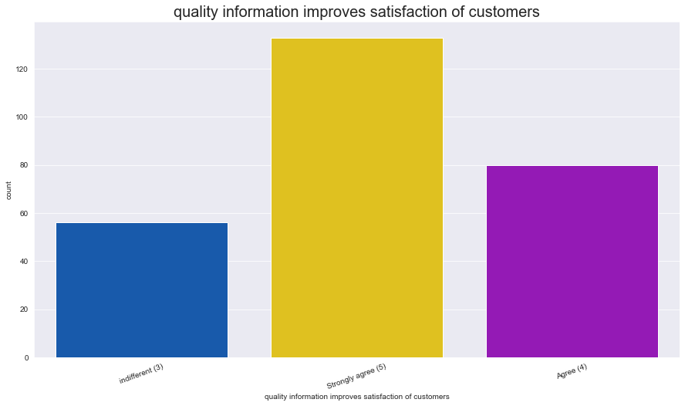

Slide 17
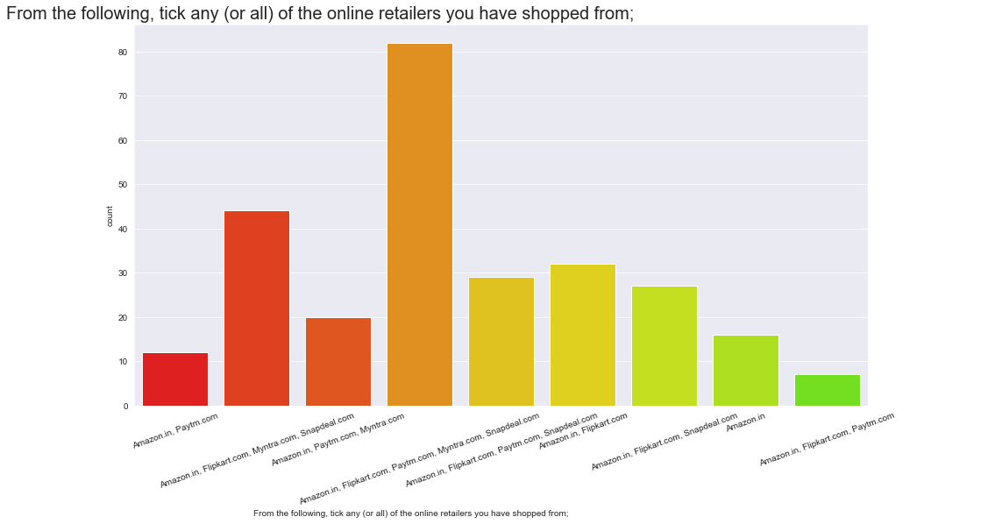

Slide 18
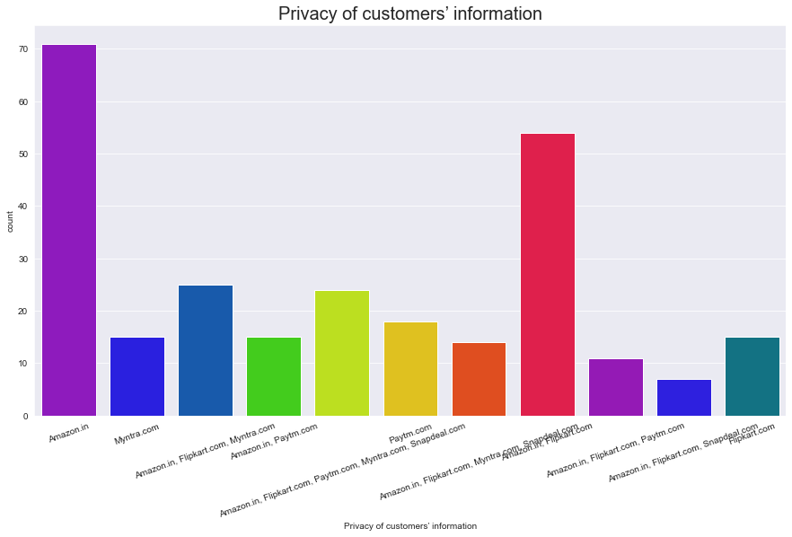

Slide 19
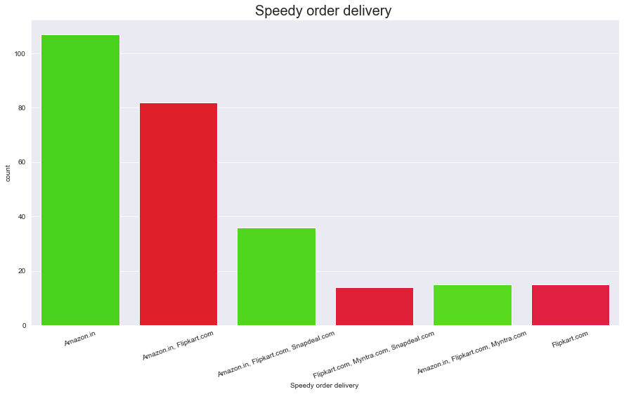

Slide 20
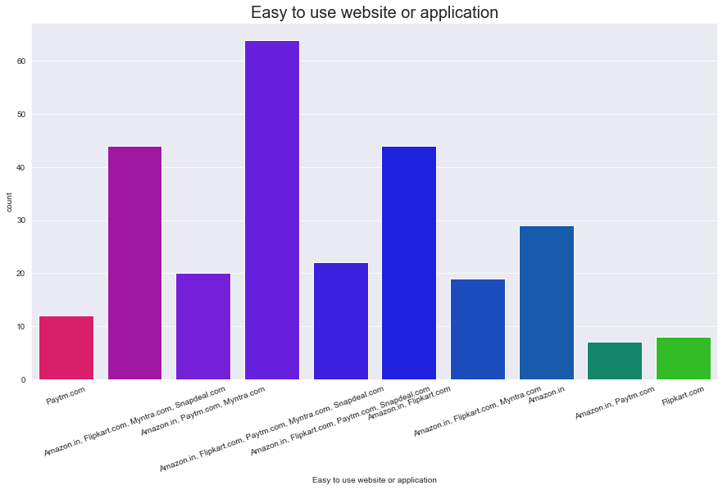

Slide 21
Females shop more than males, hence they're the target audience.
People in age group of 31-40 years shop the most and least is done by 51 years age group
People in metropolitan cities (Delhi, Greater Noida, Bangalore and Noida) do more online shopping.
Customers prefer Card payment option followed by COD.
Most of the customers strongly agree that
content on the website must be easy to read and understand,
Must have all the information on listed seller and product,
There must be ease of navigation in website,
Must have convenient payment method,
must have empathy towards the customers
online shopping gives monetary benefit and discounts
There must be return and replacement policy of the e-tailer for purchasing
Customers agree that they are Getting value for money spent
They also strongly agree that Amazon.in,Paytm.com and Myntra.com are easy to use and maximum shopping is done from these websites, also they have complete and relevant information of products
Amazon and flipkart offer wide variety of products Amazon has fastest delivery followed by flipkart and myntra. Also they are highly satisfactory in terms of privacy of customer information.
Moreover Amazon website is best since its extremely efficient. Snapdeal provides limited mode of payment and has frequent disruption on moving from one page to another. Most of the people would refer Amazon to others.
Observations

Slide 22
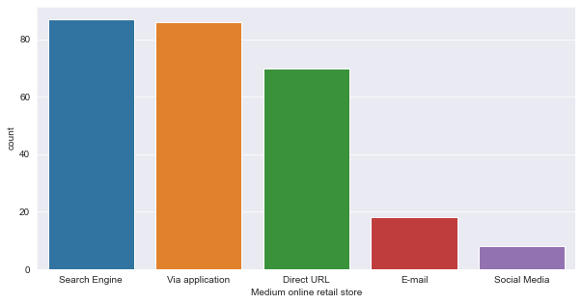
Most of the customers have downloaded the app after their first usage of the online retail store. We can safely assume that these customers have been retained by the E commerce website as they have downloaded the application on their phone and have a fair chance of shopping again.
Also, there are a few customers who are using Desktop/Laptop, for which, there are no applications for online shopping and they have to stick with the web browser.

Slide 23
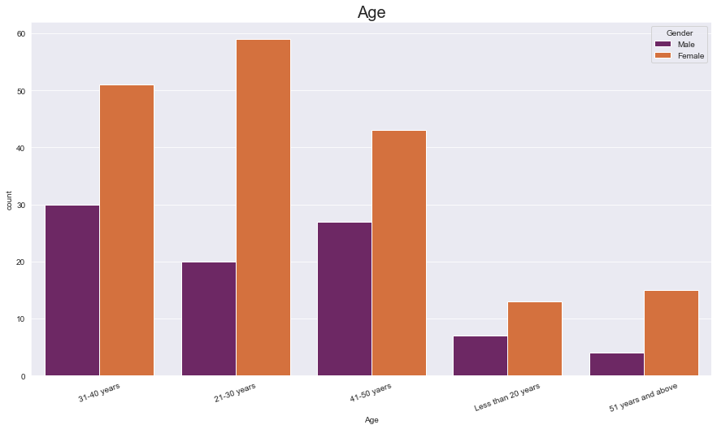

Slide 24
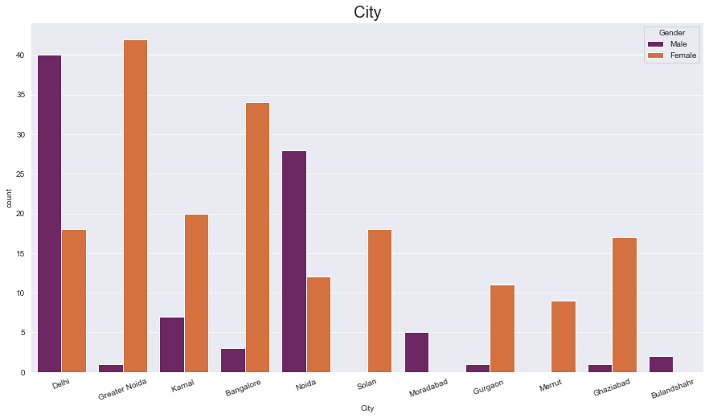

Slide 25
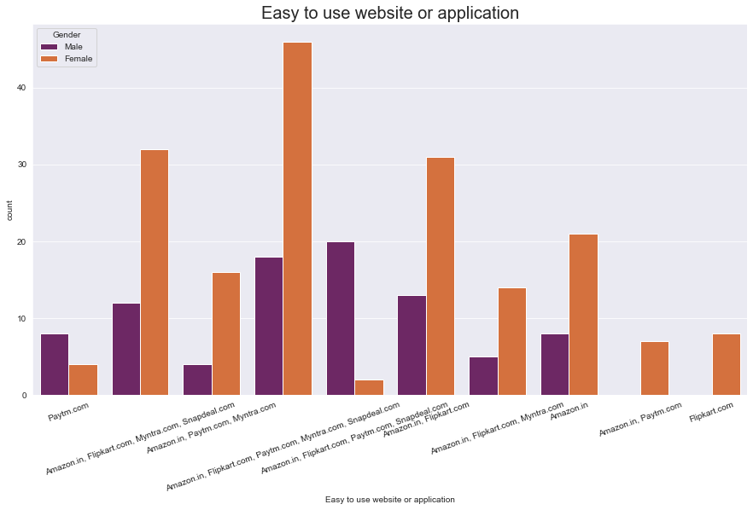

Slide 26
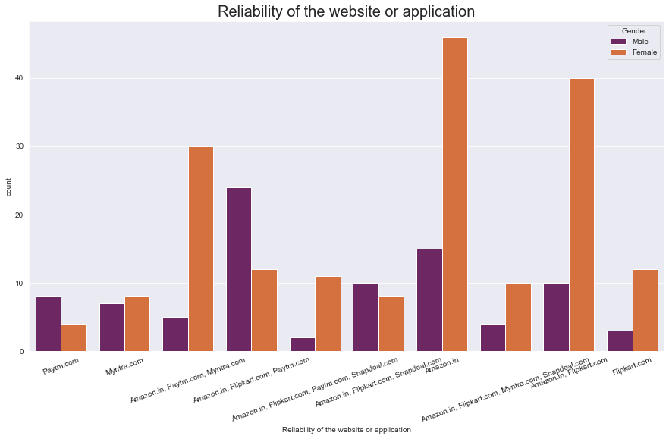

Slide 27
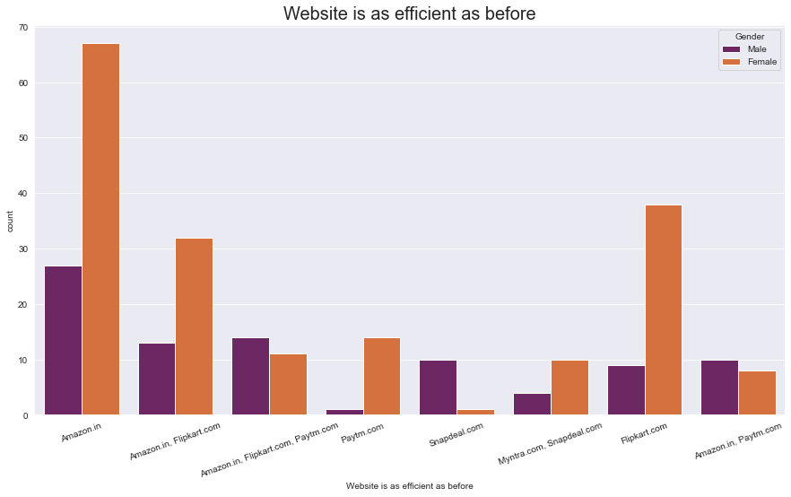

Slide 28
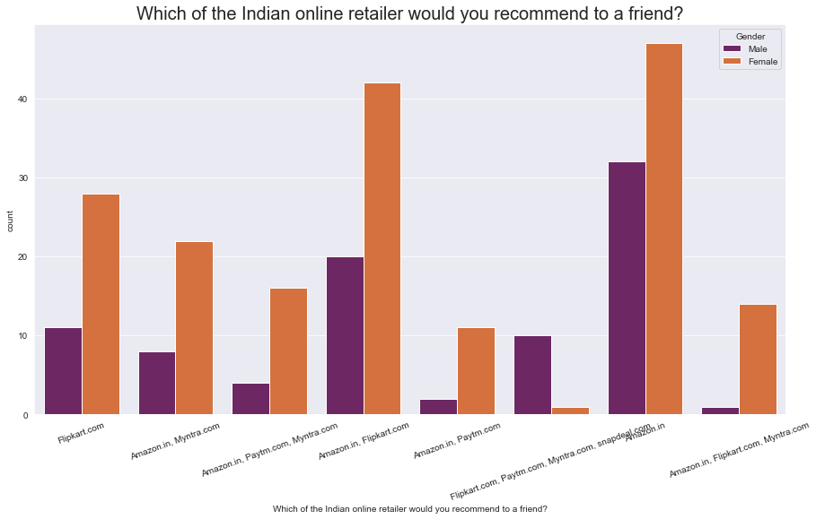

Slide 29
Females in age group 21-30 years do majority of shopping
Females from Greater Noida and males from Delhi do majority of shopping
Most of the females shop from amazon, flipkart, paytm, myntra, snapdeal as they find it easy to use and also find amazon reliable
Males find amazon,flipkart and paytm to be equally reliable.
Both male and female agree that amazon is as efficient as before .
Moreover they both would recommend amazon to a friend.
Observations

Slide 30
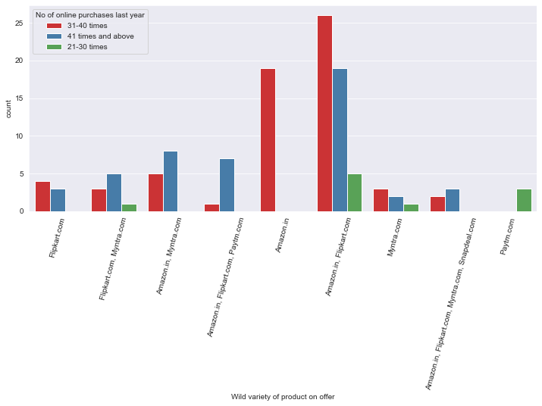

Slide 31
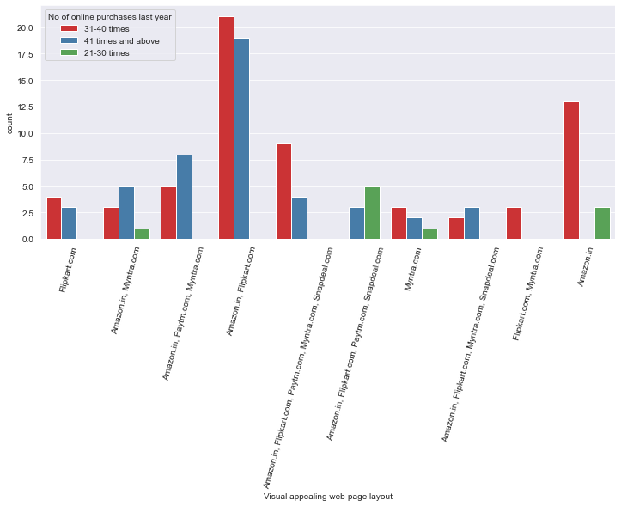

Slide 32
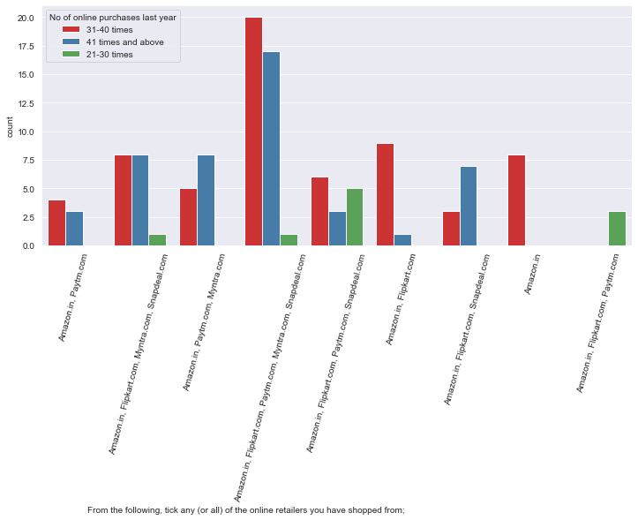

Slide 33
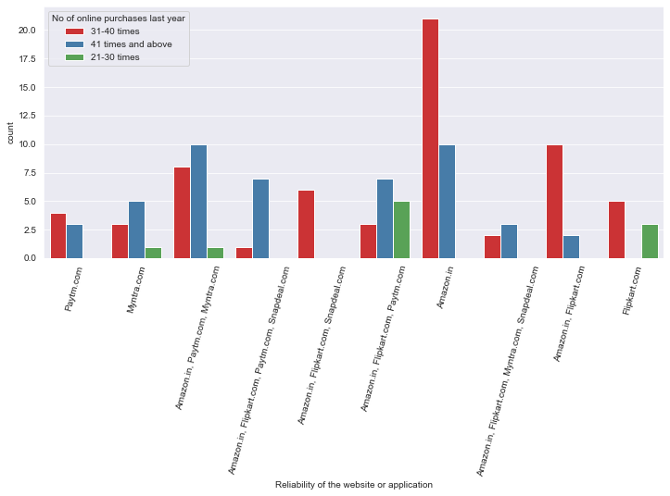

Slide 34
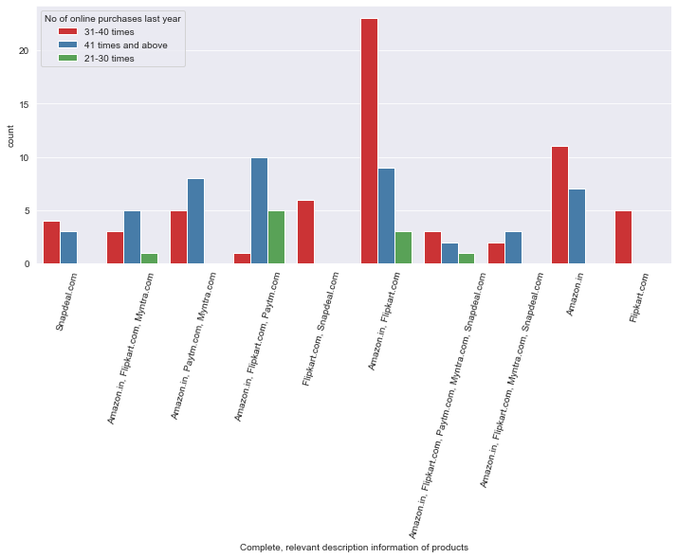

Slide 35
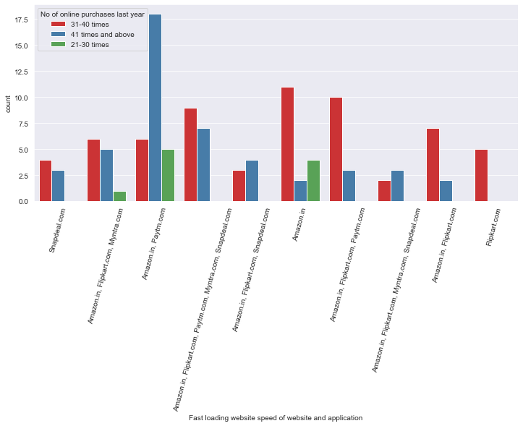

Slide 36
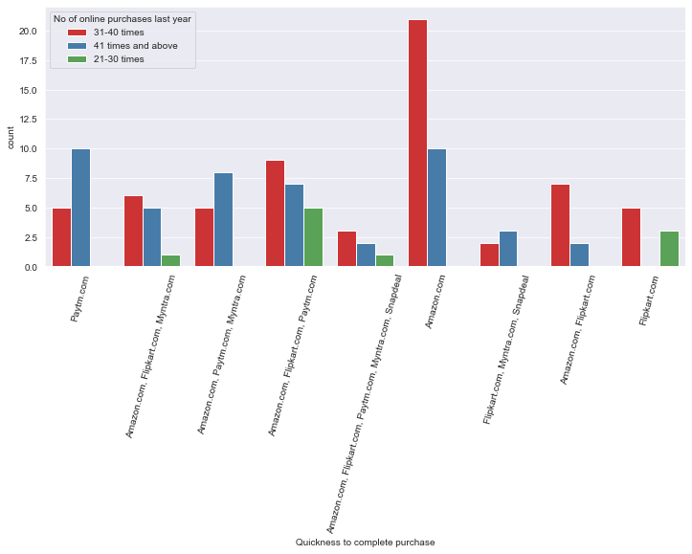

Slide 37
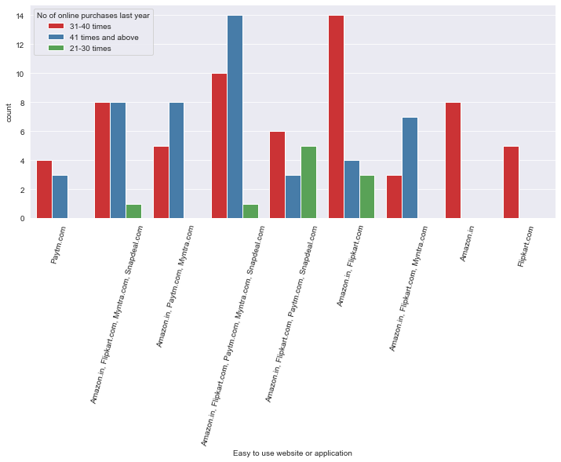

Slide 38
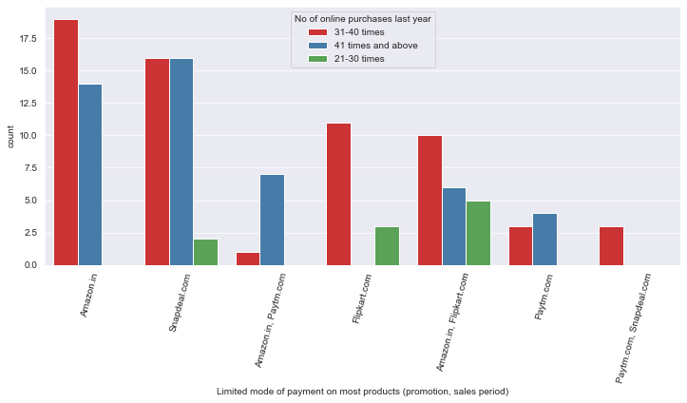

Slide 39
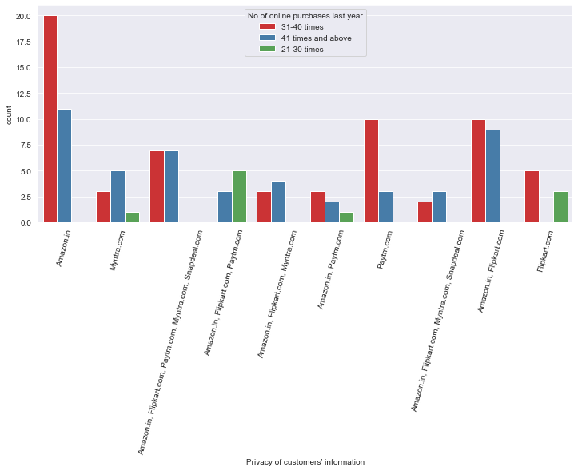

Slide 40
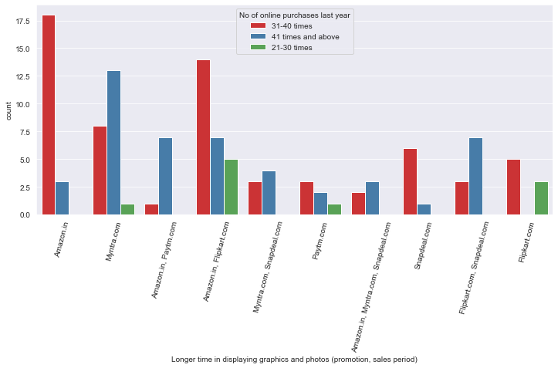

Slide 41
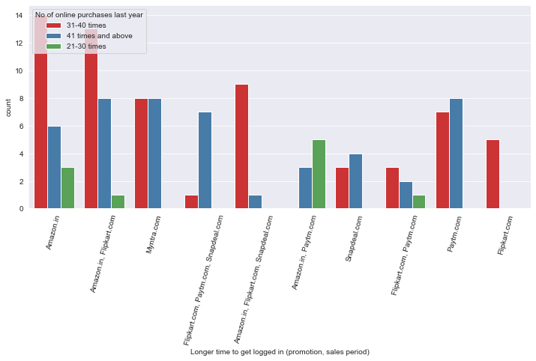

Slide 42
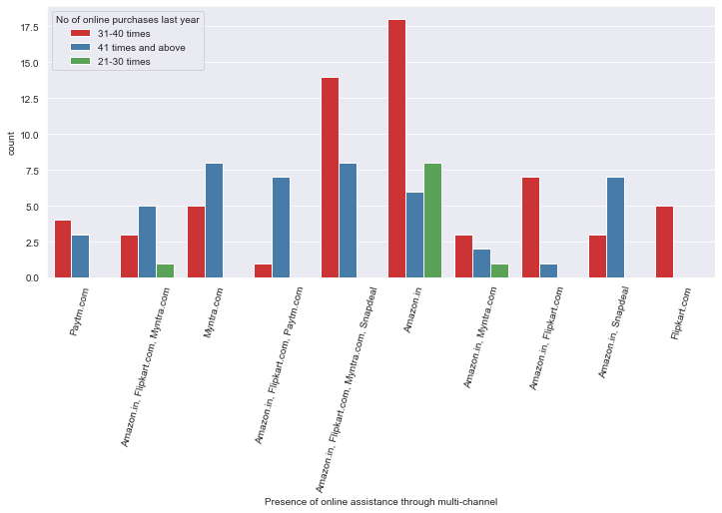

Slide 43
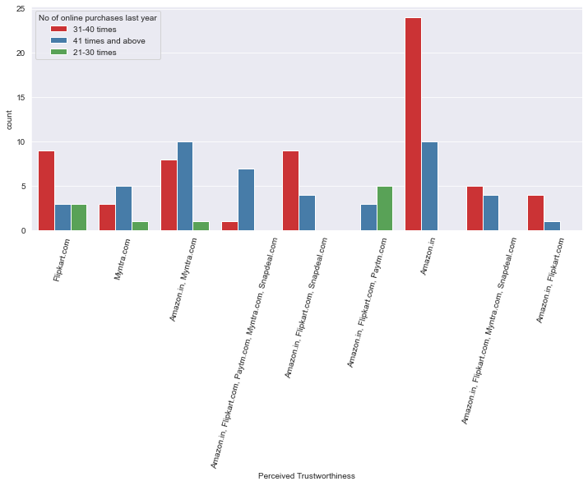

Slide 44
Majority number of customers have shopped from amazon, paytm and myntra
Majority number of customers like amazon, paytm and myntra web page layout
Majority number of customers like amazon and flipkart in terms of variety of product offered
Majority number of customers like amazon and flipkart in terms of relevant and complete description of products
High proportion of high purchase frequency customers like amazon and paytm in terms of website speed
Most reliability is obtained from amazon and flipkart
Majority number of customers like Amazon in terms of quick purchase
For payment option Amazon, flipkart and myntra are liked most by the high purchase frequency customers
Amazon stands apart in terms of speed of order delivery and privacy of customers information
Highest number of customers like amazon,flipkart in terms of security of customer private information
Amazon perceived highest trustworthiness of high purchase frequency customers
Most of customers like amazon in terms of online assistance through multichannel
Most user claims flipkart to take maximum login time during sales/promotion
majority of customers claims myntra to take maximum time in displaying graphics and photos
Observations

Slide 45
Thank You

